Slide 1
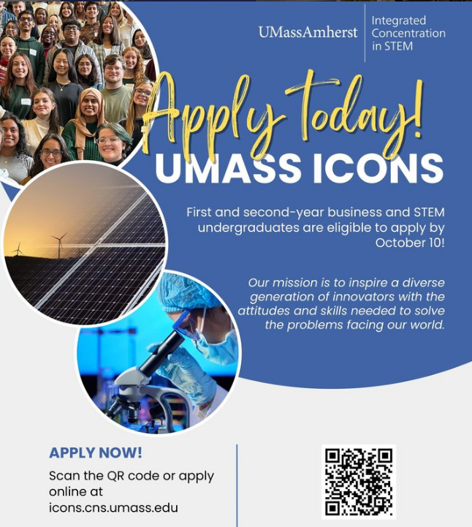
s
and Business

Slide 2

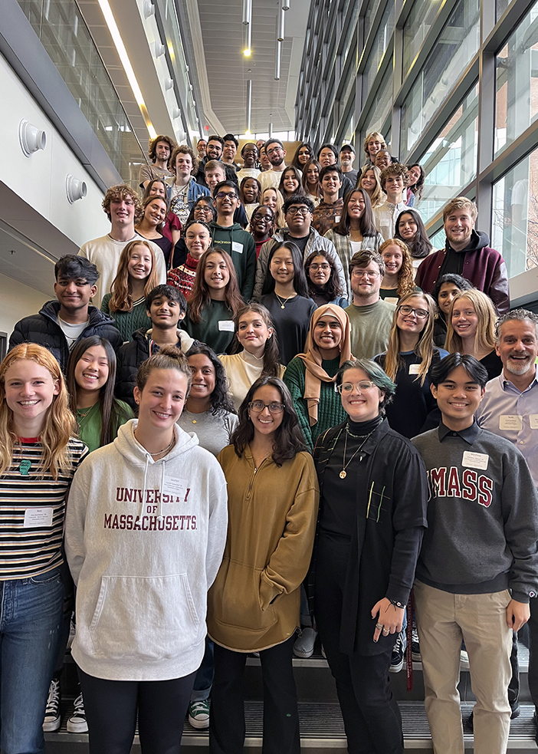
problem solvers.
innovators.
communicators.
Cohort 13

Slide 3

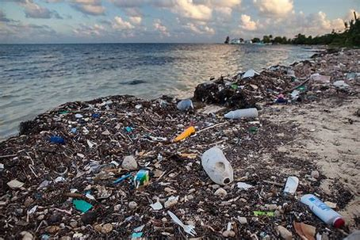


Today’s society faces urgent challenges: Developing clean energy, curing disease, producing drinkable water, and responding to climate change.
iCons Program is an interdisciplinary course where STEM & Business majors come together to work on solutions today’s most urgent challenges.
Notes:
What is the iCons program?

Slide 4
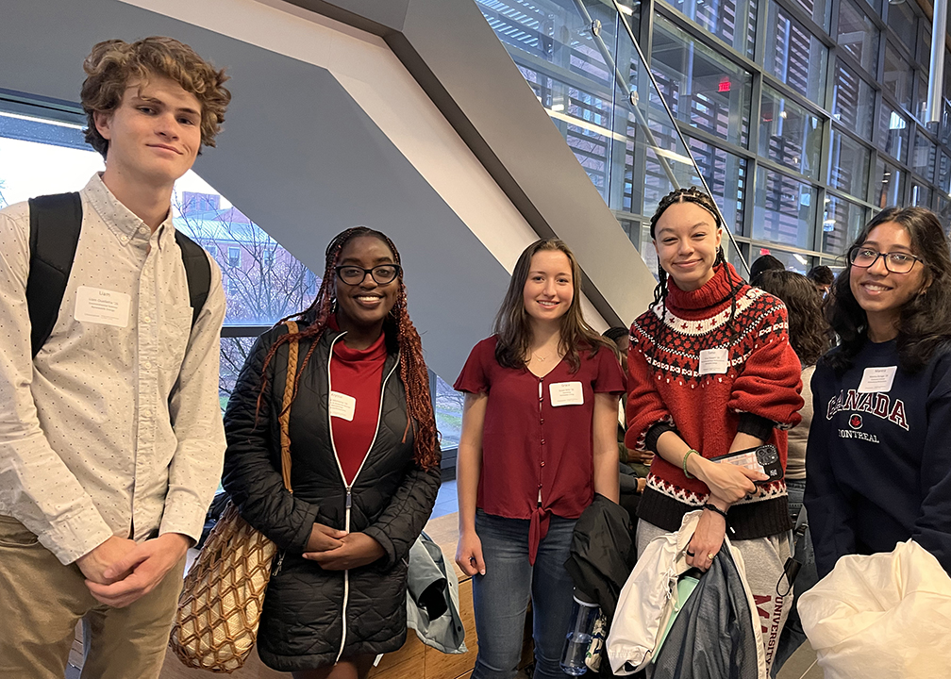
The iCons Program is at the cutting-edge of integrative education, bringing together undergraduate students from all walks of science, engineering, public health, and business to:
Collaborate on complex societal issues in diverse teams
Understand multi-faceted problems from multi-disciplinary perspectives
Develop and study creative solutions to real-world challenges.
Be Revolutionary.

Slide 5
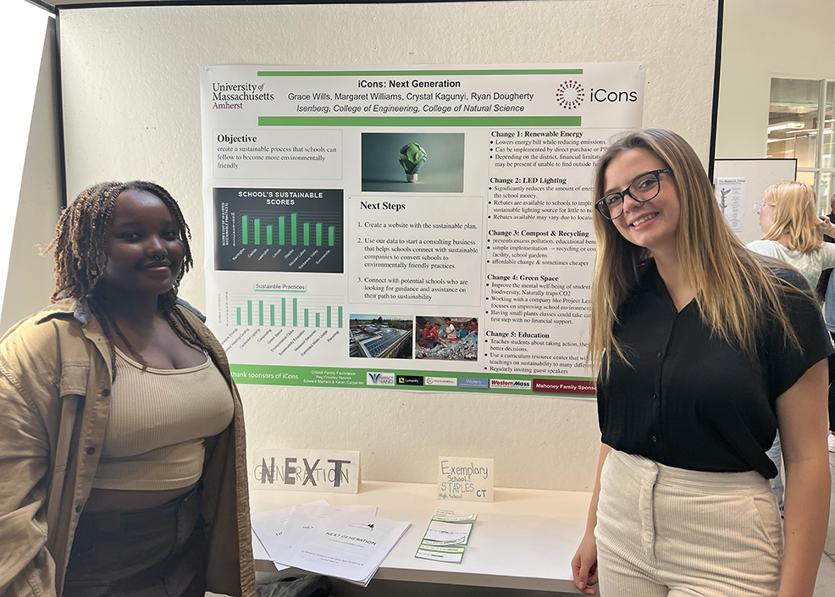
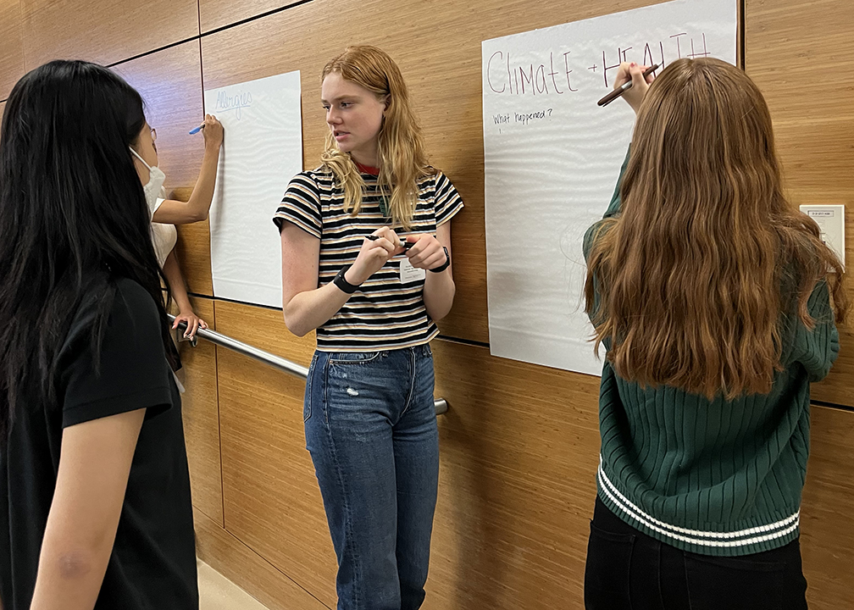
Why iCons?
Standard science instruction alone does not provide students the breadth of training they need to succeed as future leaders in industry, government, or academia. New skill-sets in collaboration, communication, leadership, and interdisciplinary thinking defines the needs of today's technical workforce.

Slide 6
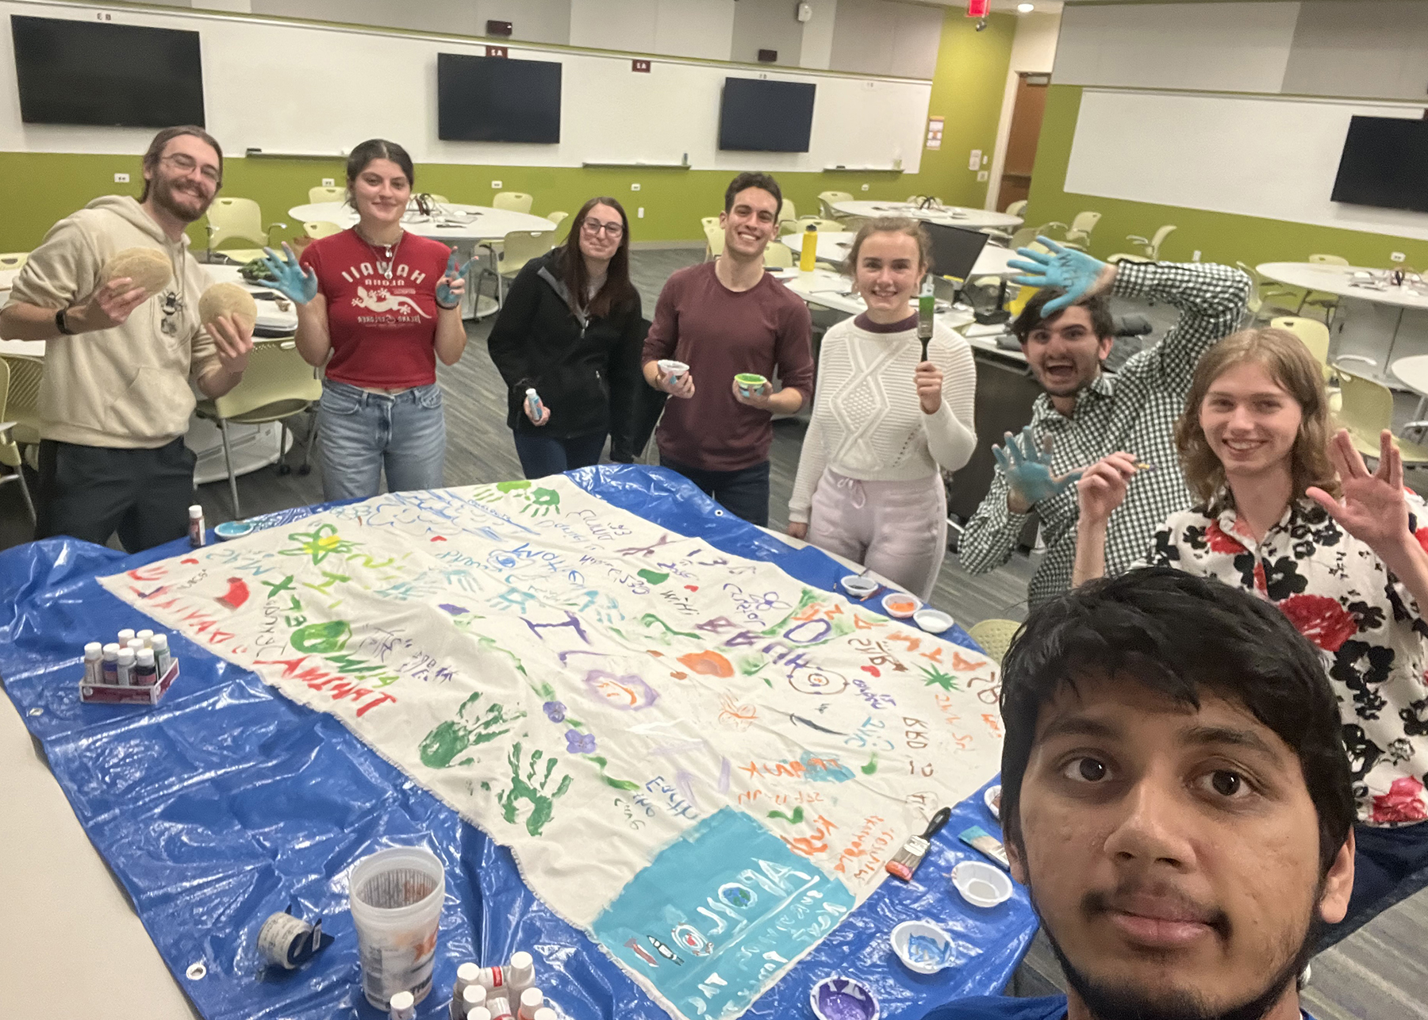
What makes this class different?
Class is geared towards your individual interests!
You essentially get to build the curriculum and get to use your creative skills to constructive research projects setting your own goals, expectations, and desired outcomes.
Guest speakers on related topics present during class on current event issues and solutions.
Get to work with other students in different majors and utilize each other’s strengths to form solutions.
Hands on class style keeps you engaged!
Feedback oriented… Professors are always looking for feedback in ways to improve the class and what you want to learn more about!

Slide 7
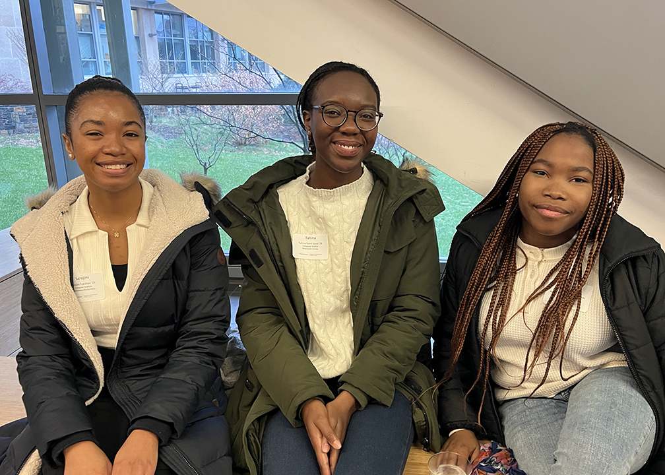
How iCons benefits you…
HUGE Resume builder!
Great way to stand out from the crowd and get an edge on the competition.
Certificate in Real-World problem solving
DIRECT Internship Opportunities
Organizations come to our program to ask for iCons students to work with them on their projects.
EVENTS!
Idea SLAMs- a business comes and presents their problem to iCons students to brainstorm potential solutions
Fun Activities amongst Cohorts (trivia & movie nights)
Networking opportunities
EXCLUSIVE Study Room
Designated Room in LGRT Research Building exclusively offered to iCons students.

Slide 8
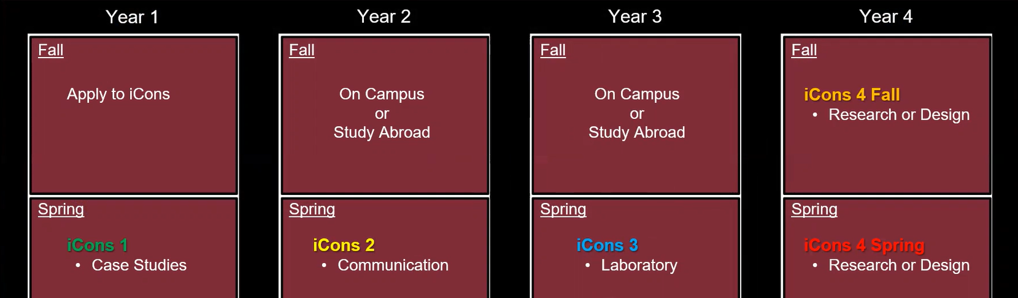
iCons Program Structure
Counts for Courses You Already Need to Take
Fits Into Your Academic Schedule

Slide 9
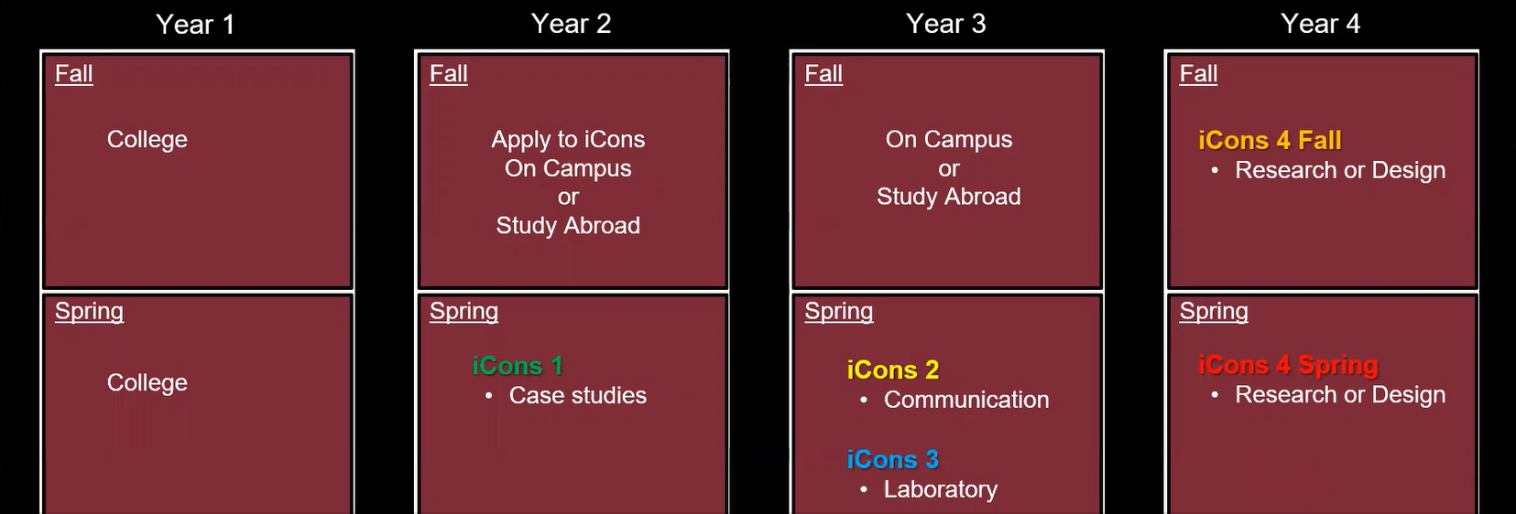
iCons Program Structure
Counts for Courses You Already Need to Take
Fits Into Your Academic Schedule

Slide 10
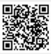
How To Apply!
Go to https://icons.cns.umass.edu and click on Apply Now box.
Or find iCons website by searching iCons UMass in Google
Fill out application form (3 questions)
Q1: Share an example of how your lived experience informs your approach to learning and how your perspective will enhance the UMass iCons Program. (250 words)
Q2: How does iCons help you advance your career? (250 words)
Q3: What’s a big problem and how can Business & STEM solve it? (250 words)
Submit!
DEADLINE: TUESDAY, OCTOBER 10th 11:59PM (EST)

Slide 11
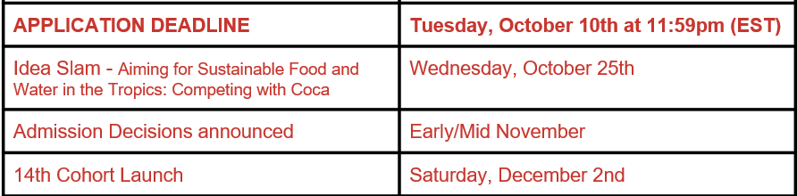

Important Dates!
Website: https://icons.cns.umass.edu
@iconsumass

